Slide 1






Panorama Stitching
Fernando Gómez
Jordi Guimerà

Slide 2
Introduction
The aim of this project is to create a program that stitches a set of given images taken from a single viewpoint to form a panorama, using feature extraction algorithms and RANSAC.

Slide 3
IMPLEMENTATION
The project is developed in a single Python script making use of the OpenCV and Numpy libraries.

Slide 4
Outline of the program
- Feature extraction from input images.
- Feature matching
- Estimation of homography matrices using RANSAC
- Fitting the transformed images with respect to the center image into a canvas

Slide 5
Feature extraction
Implemented through the function findKpDesSIFT or findKpDesORB (default SIFT)
Both functions iterate through the images and compute the keypoints and descriptors of each image making use of the OpenCV SIFT object or ORB object and executing their method detectAndCompute() with the corresponding algorithm integrated

Slide 6
Feature matching
The function matchImgsBFM() takes the features found in the previous step and uses the Brute-Force Matching algorithm and the ratio test to find the correspondences between each pair of images.
Ratio Test: from one key point, two corresponcences are found. If one is significantly better than the other (the ratio determines how much), then we keep the better correspondence.

Slide 7
Estimation of homography matrices using RANSAC
The OpenCV function cv2.findHomography() is used to estimate each of homography matrices between each pair.
The results are stored in a dictionary for easier manipulation.
The function compute_H_wrt_middle_img() returns the dictionary with the homography matrices with respect to the center image to prepare for the image transformations.

Slide 8
Fitting the transformed images
A blank canvas where the images will be fitted is created with the function get_blank_canvas().
In the function stitch() the function fit_image_in_target_space() is executed for each of the images and that way placed into the canvas, which is in the end saved.

Slide 9
Testing conclusions
ORB algorithm finds keypoints and descriptors faster tan SIFT, but performs worse in the matching computation with Brute-Force Matching, therefore, unless a better matching algorithm is implemented, SIFT is preferable for a high number of keypoints and smaller images (10000 or more).
The stitching process is quite slow for big images (> 2 MB).
At least 500 key points should be used.
SIFT looks generally better tan ORB.

Slide 10
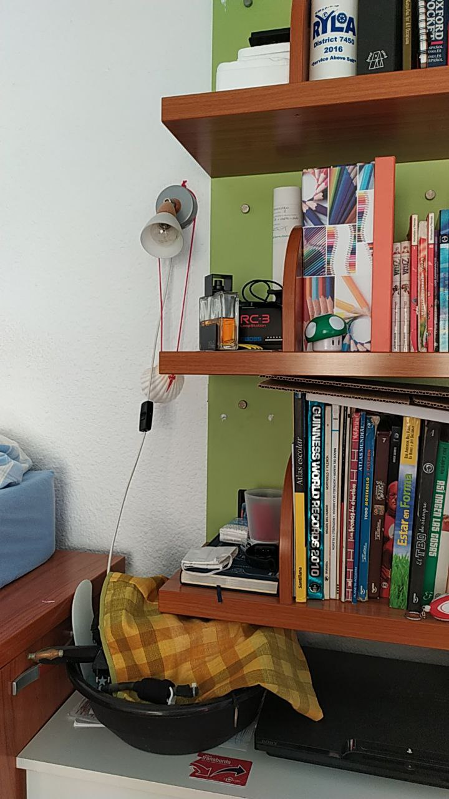
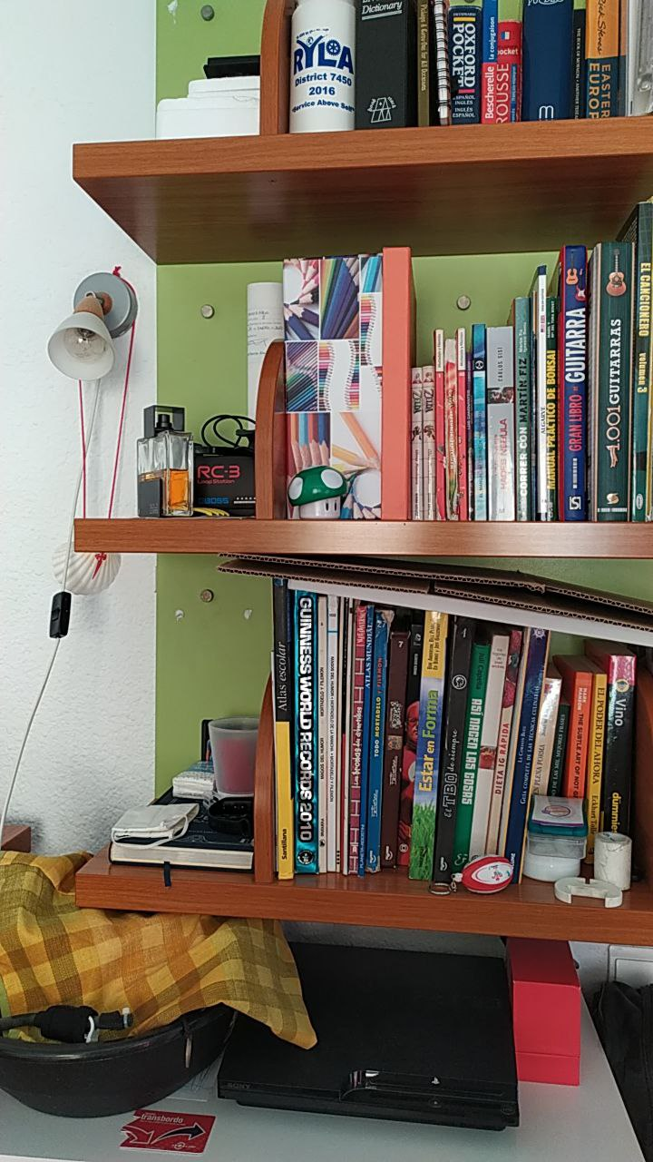
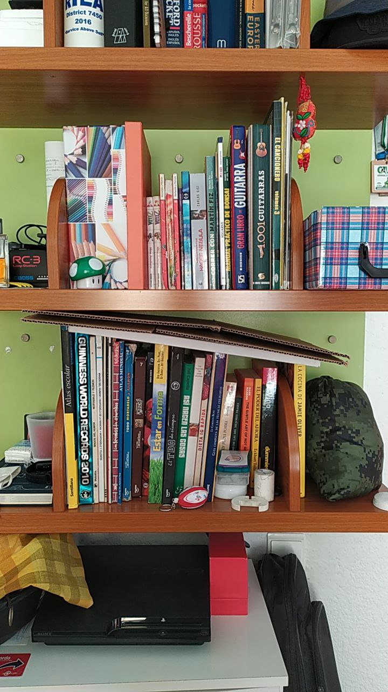
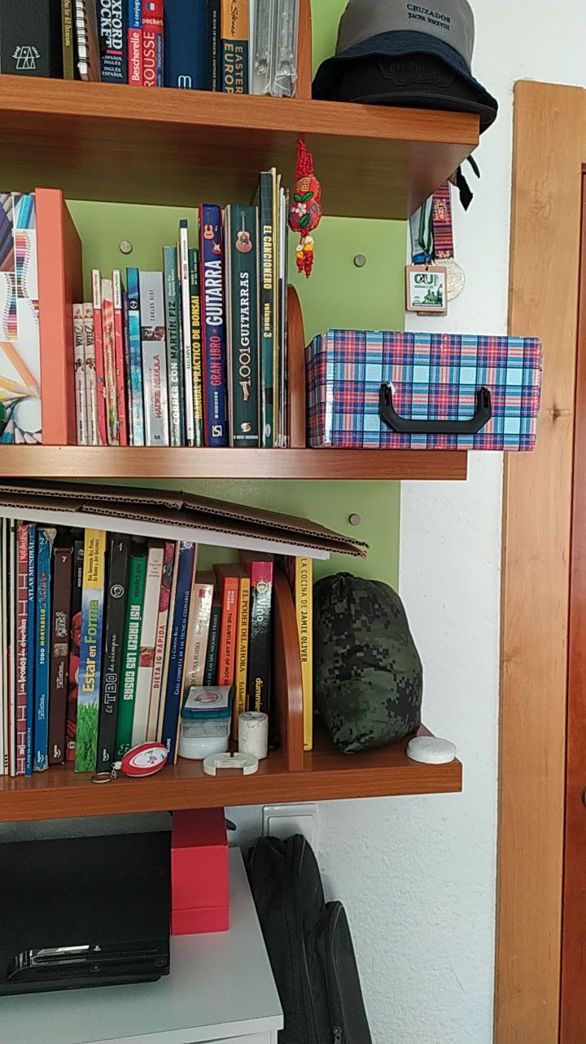
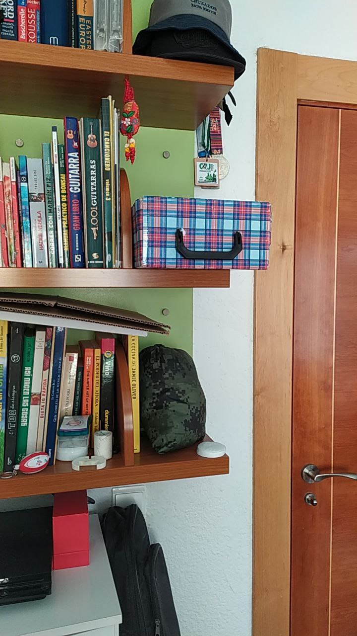
Test input images

Slide 11
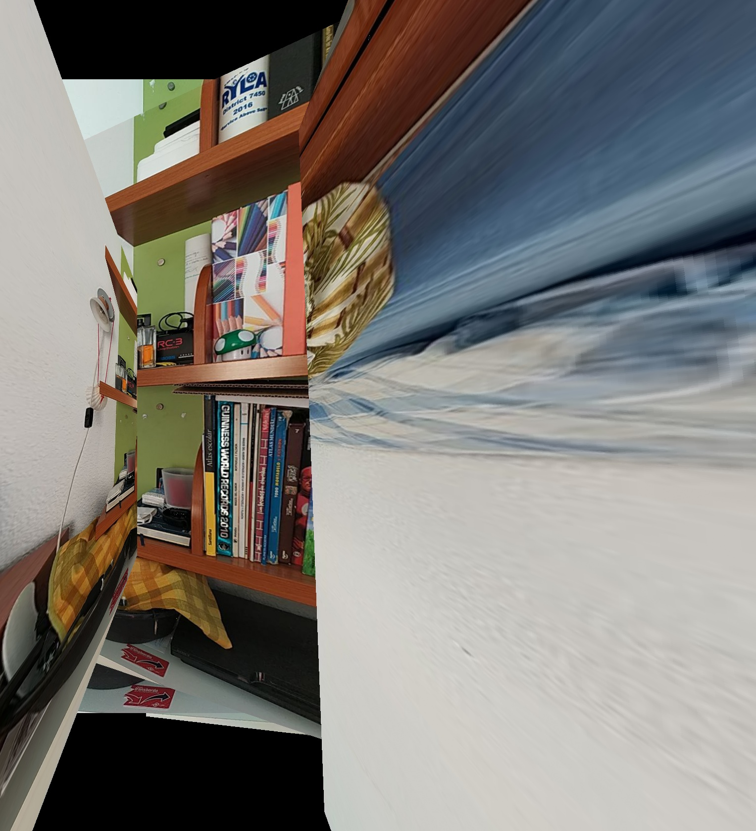
Test results
Algorithm: ORB
Keypoints: 200

Slide 12
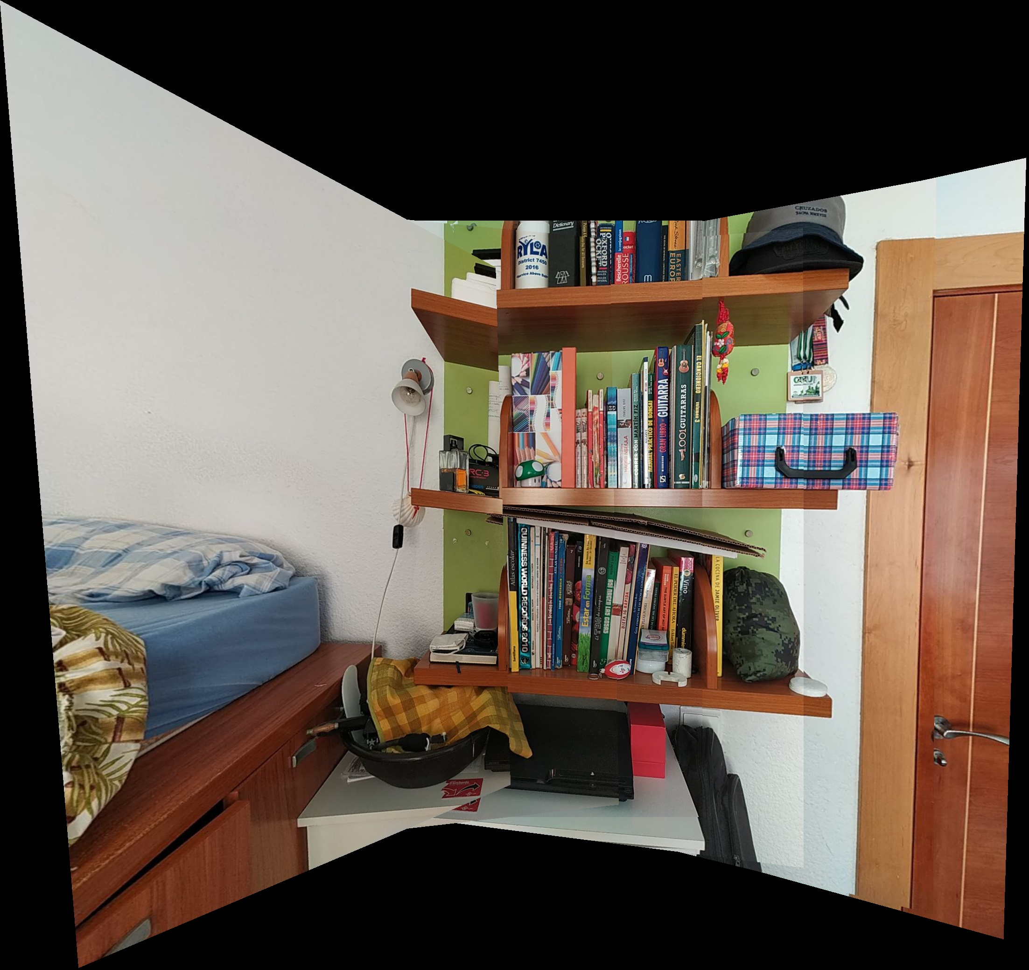
Test results
Algorithm: ORB
Keypoints: 500

Slide 13
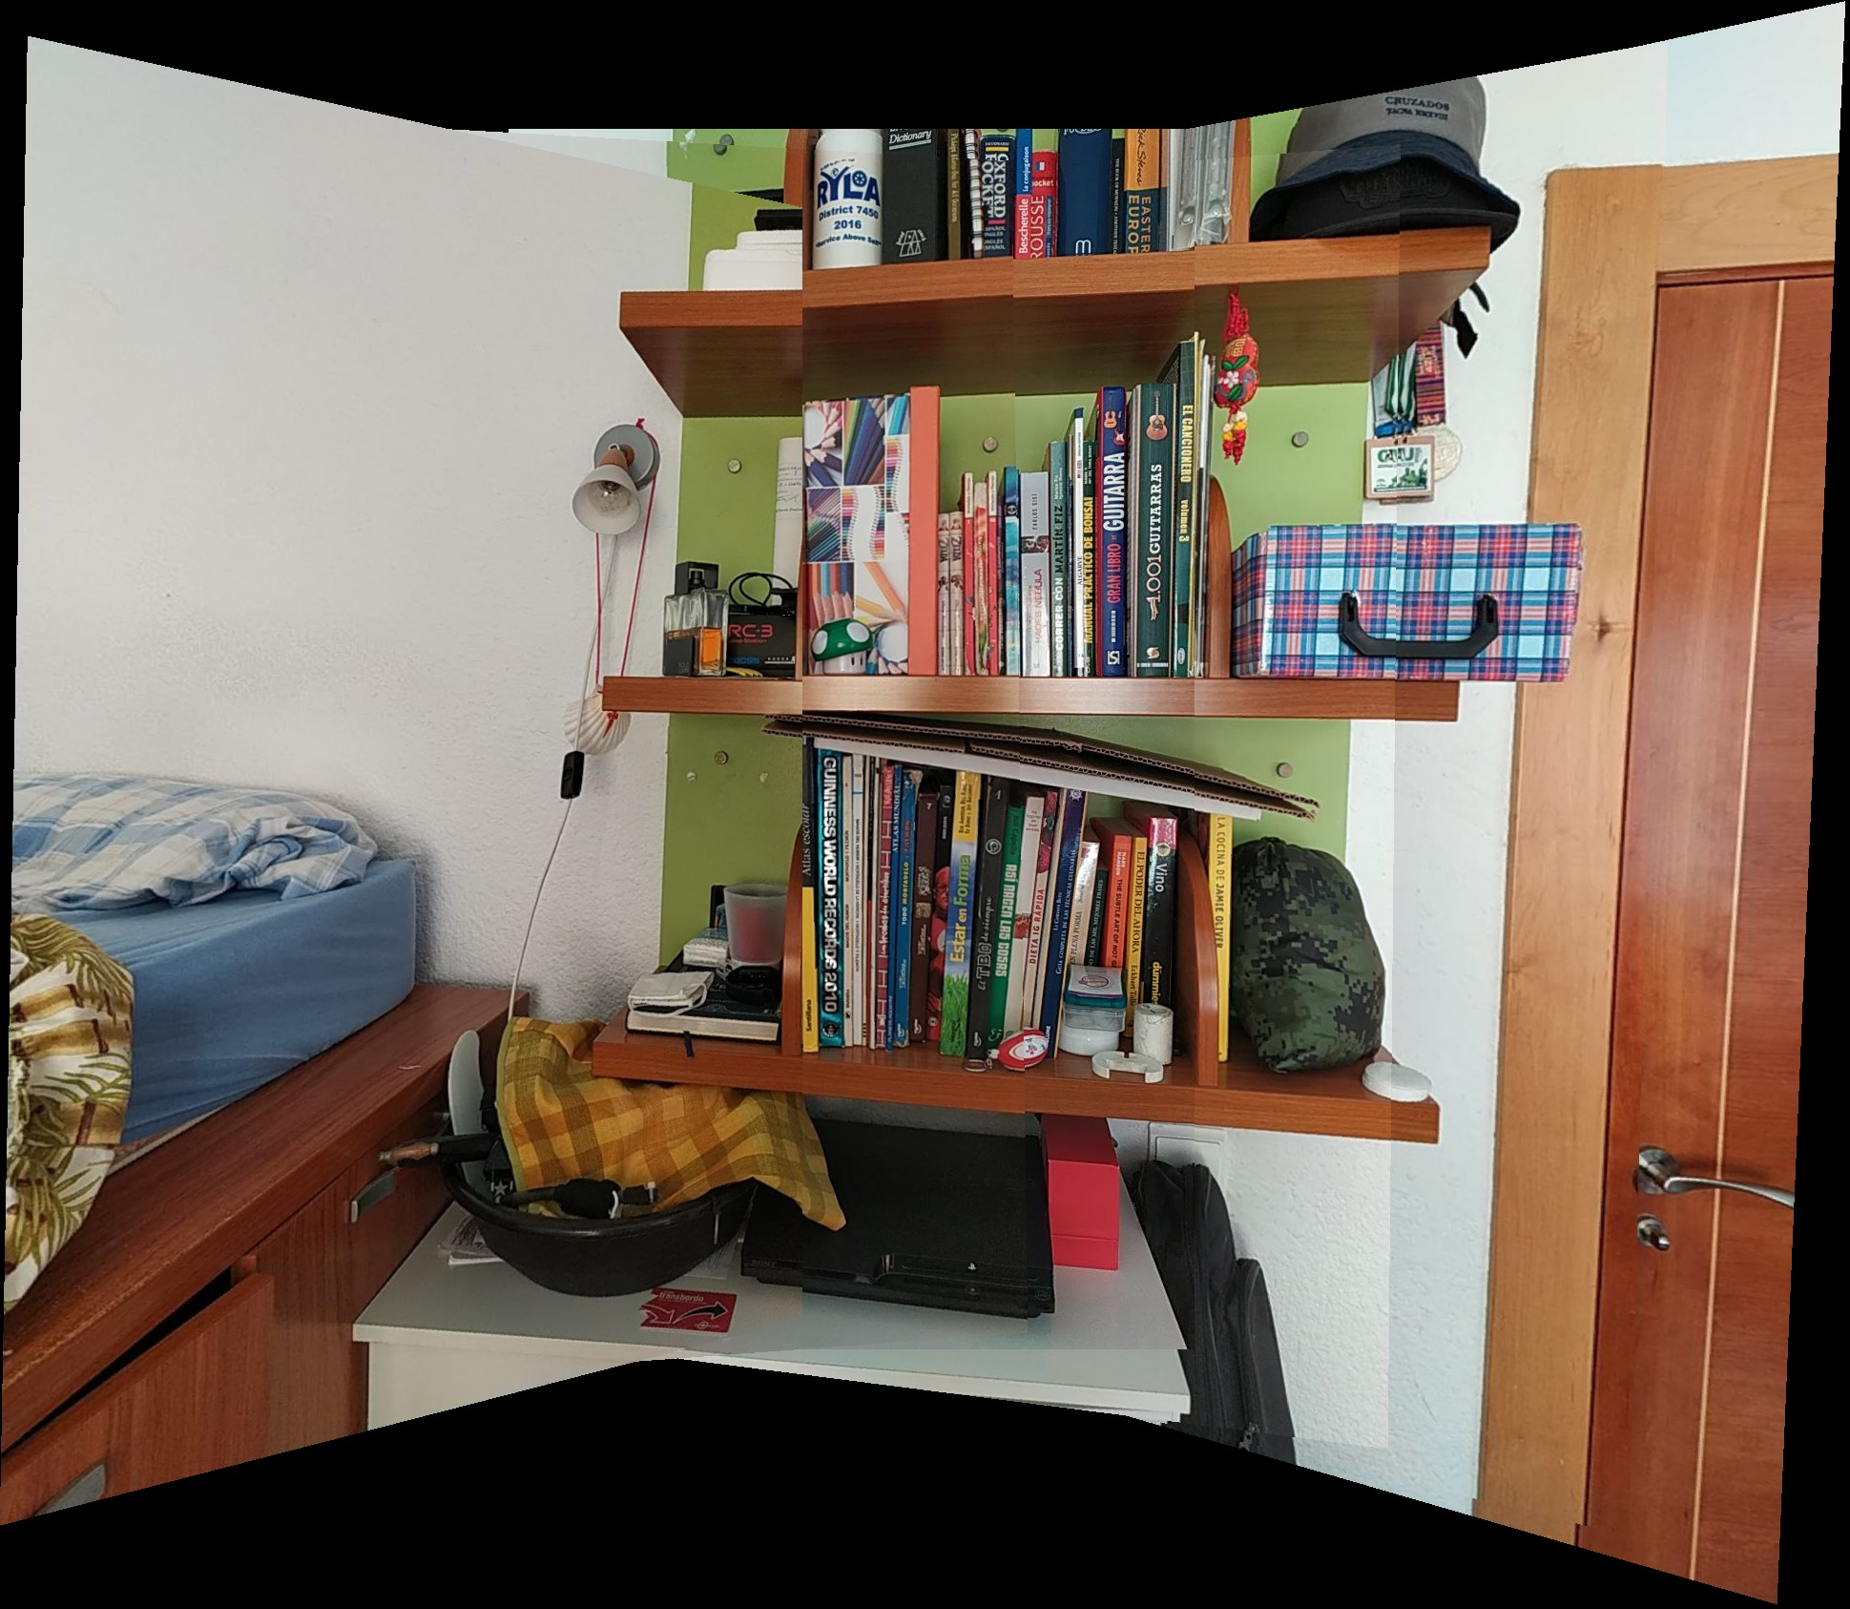
Test results
Algorithm: ORB
Keypoints: 1000

Slide 14
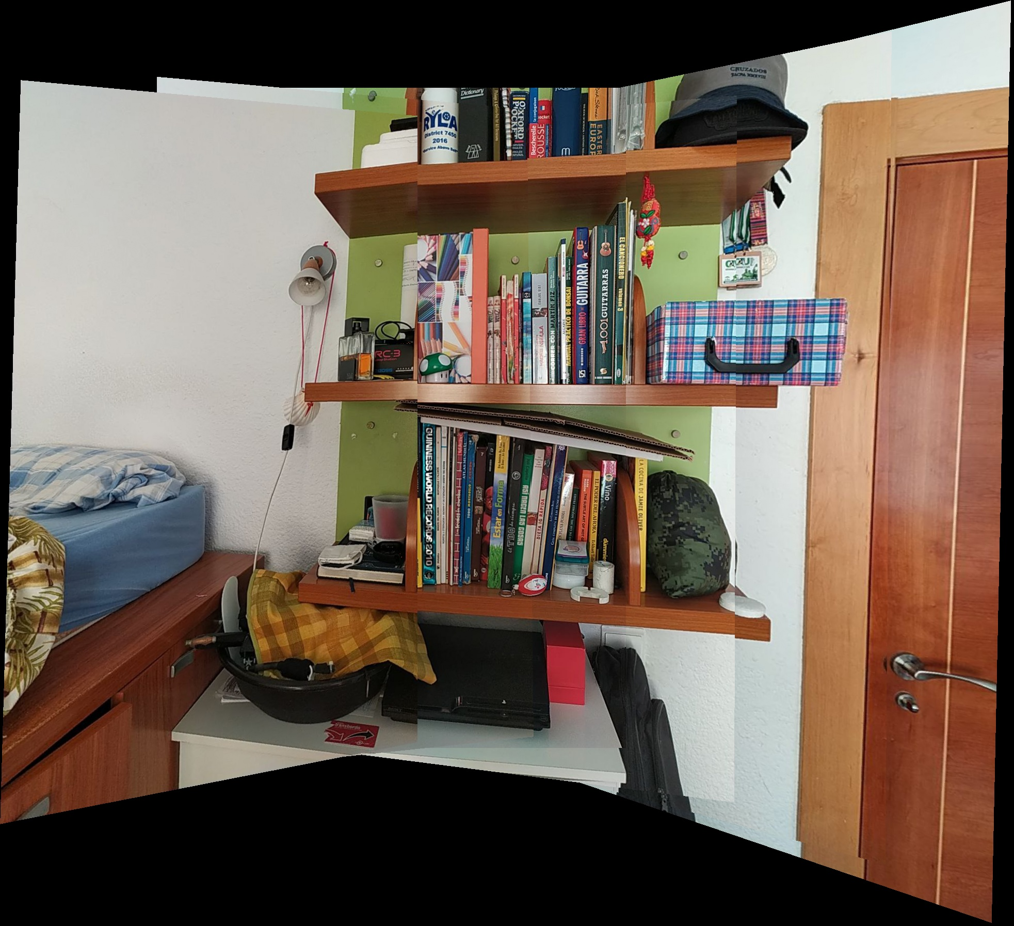
Test results
Algorithm: ORB
Keypoints: 5000

Slide 15
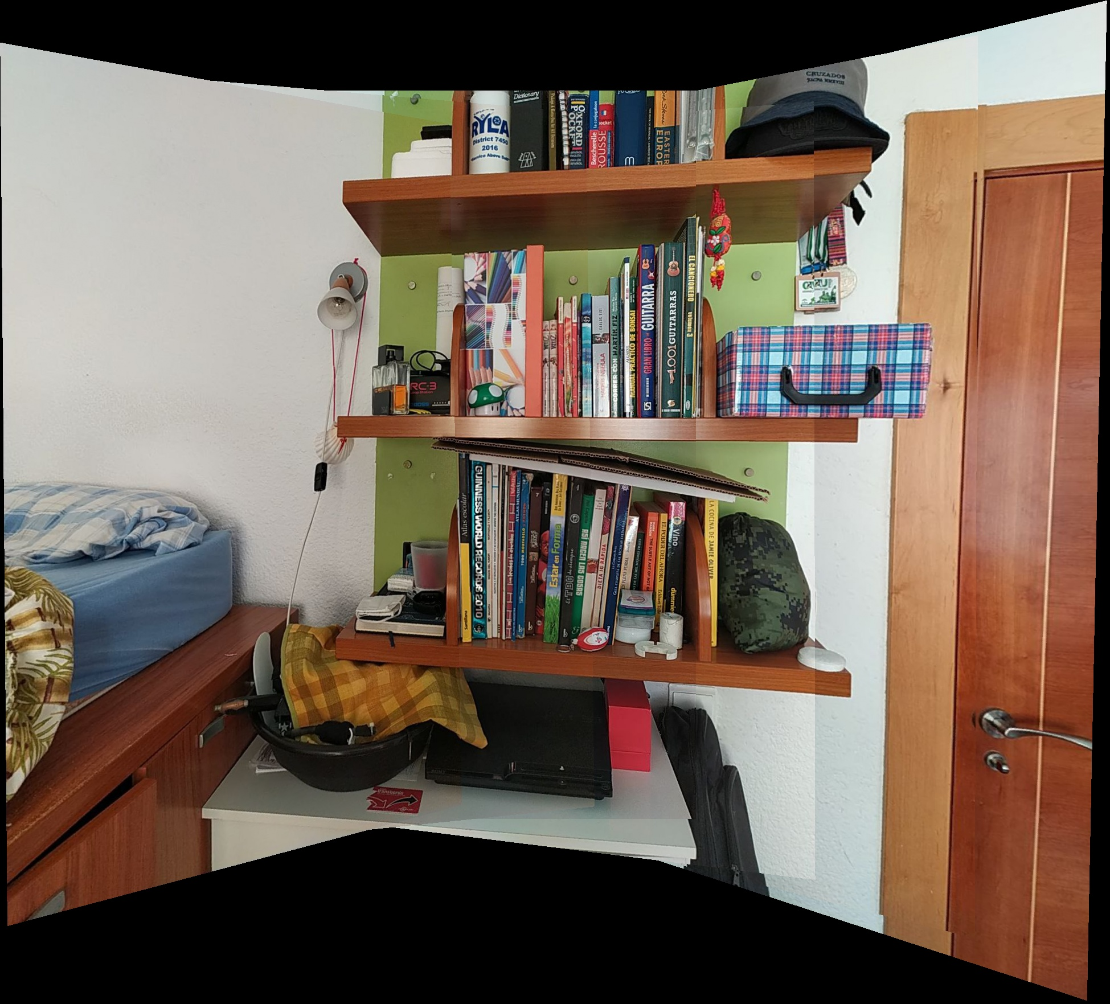
Test results
Algorithm: ORB
Keypoints: 10000

Slide 16
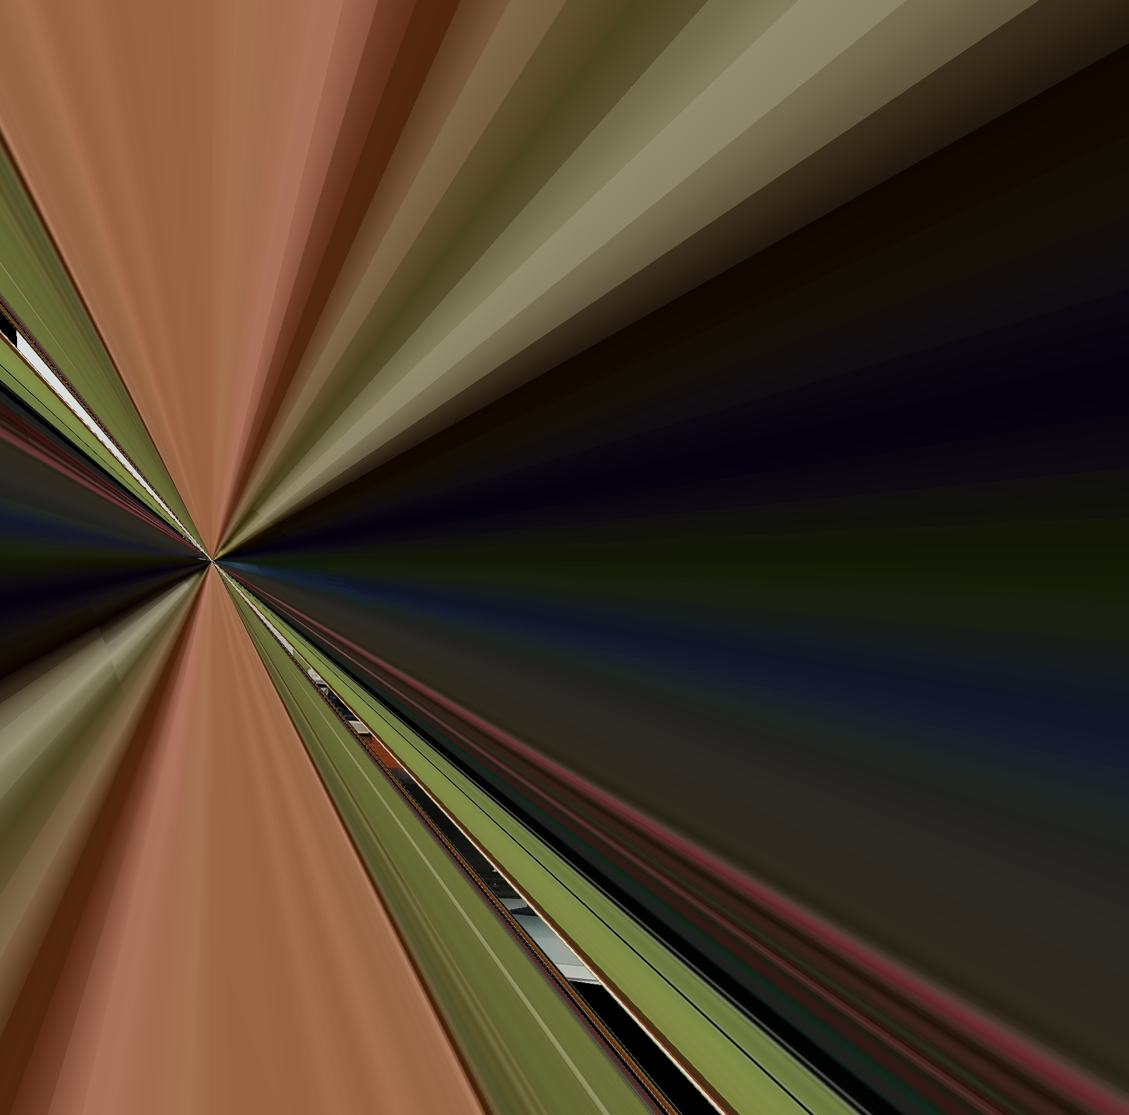
Test results
Algorithm: SIFT
Keypoints: 200

Slide 17
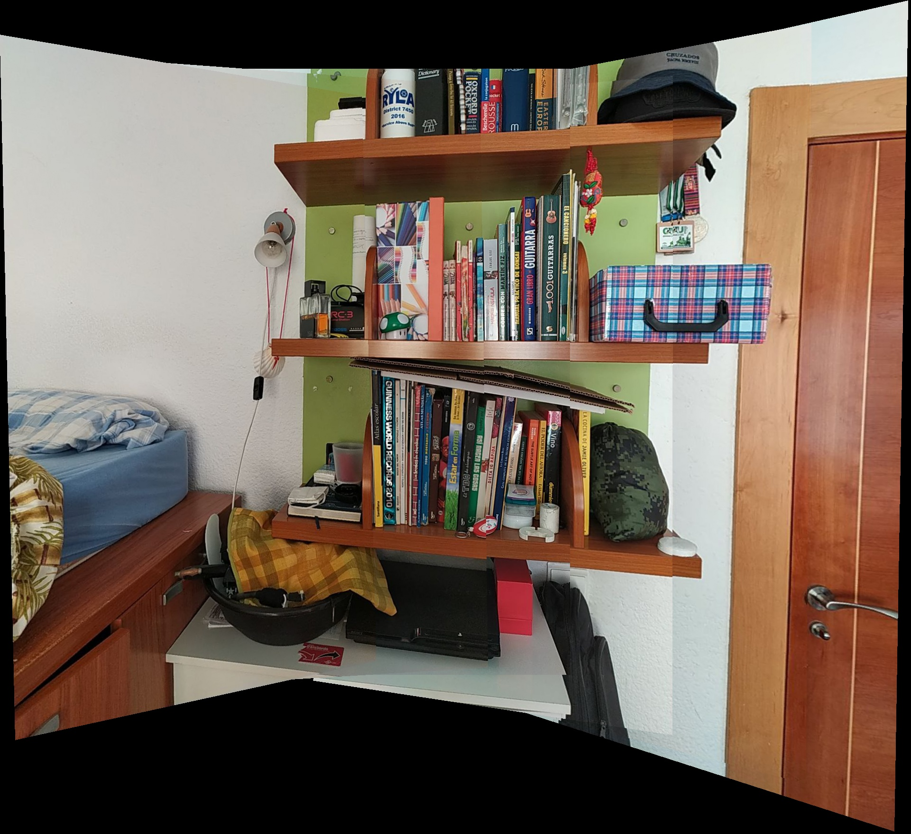
Test results
Algorithm: SIFT
Keypoints: 500

Slide 18
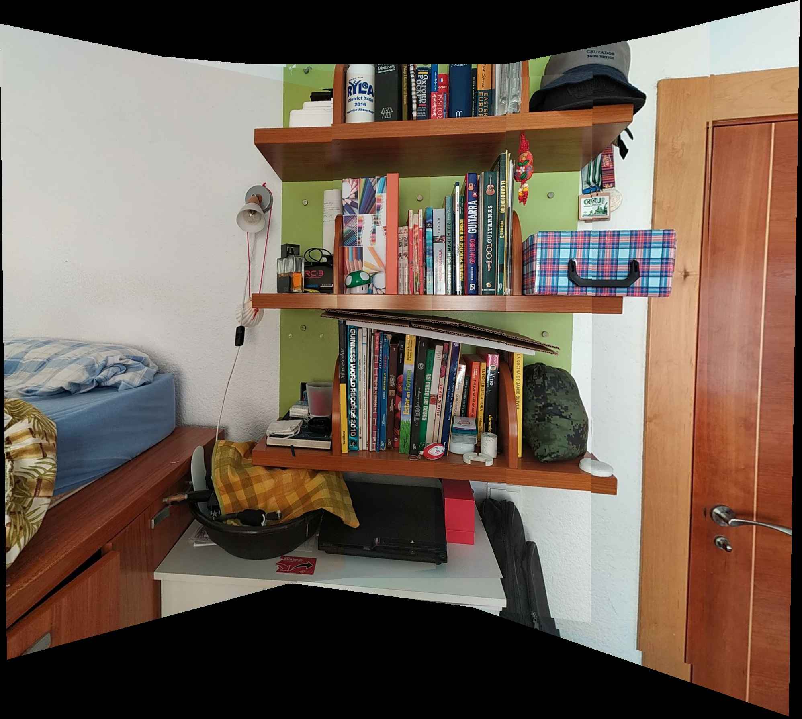
Test results
Algorithm: SIFT
Keypoints: 1000

Slide 19
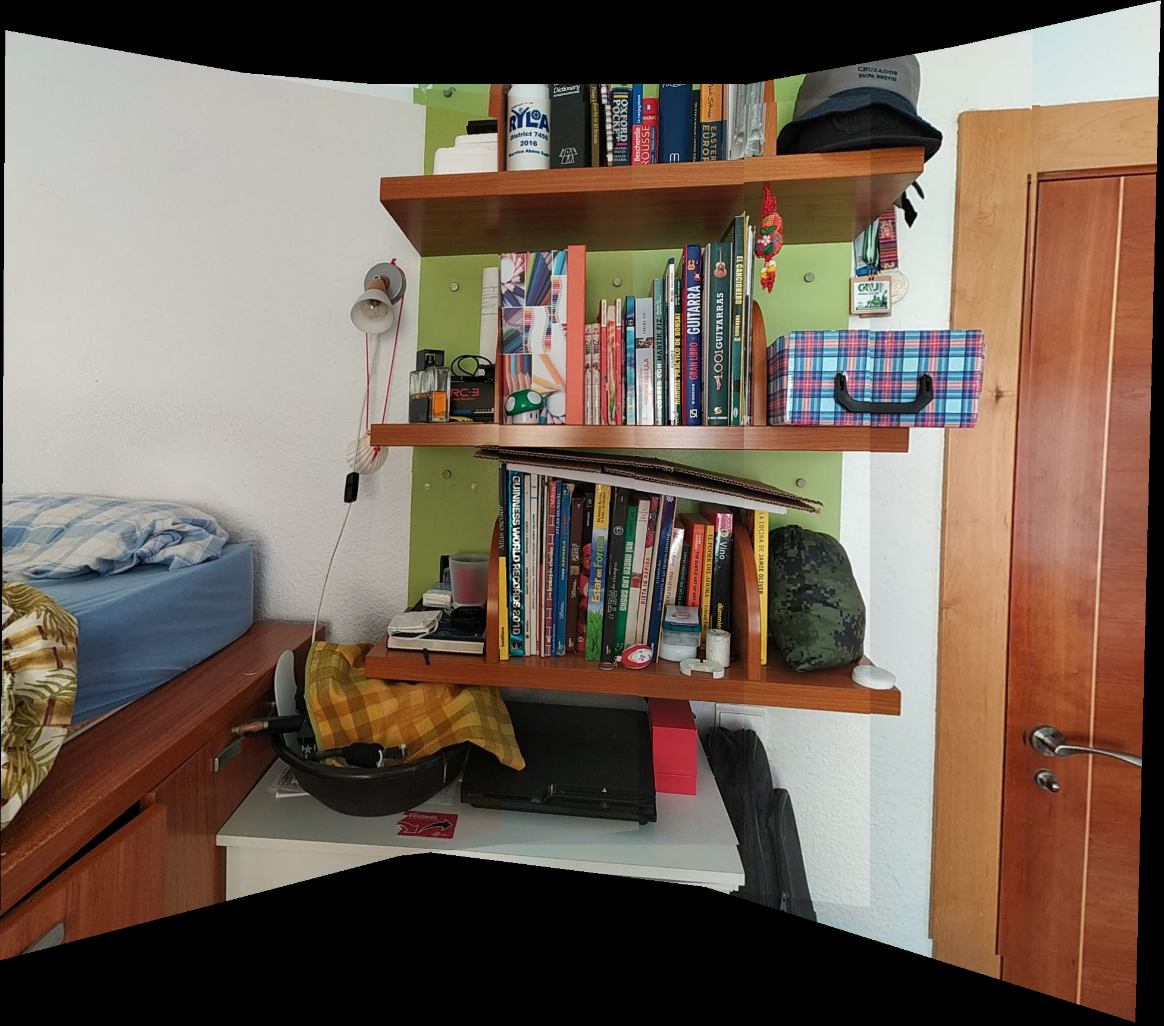
Test results
Algorithm: SIFT
Keypoints: 5000

Slide 20
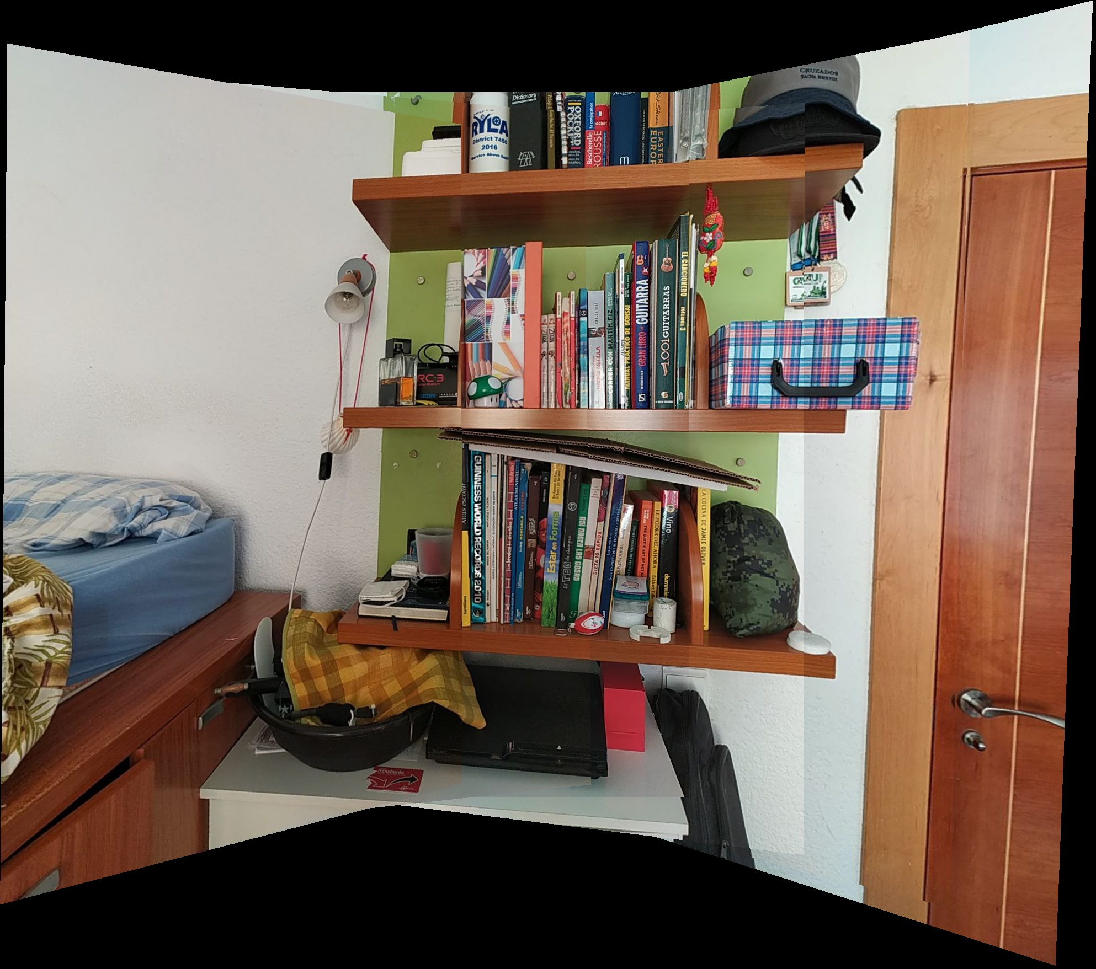
Test results
Algorithm: SIFT
Keypoints: 10000

Slide 21
Main challenges
Developing a stitching method
Overcome the general lack of experience working with Python and OpenCv.
Complications with team work.

Slide 22
Possible improvements
Optimization of the stitching process
Faster algorithm for feature matching (Flann Based matching)
Cropping of output image
Blending to soften the seams

Slide 23

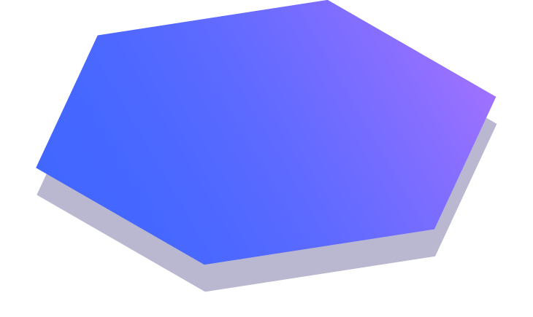
Thanks!
Do you have any questions?

